Slide 1

Deliverables
  INTRODUCING…
  Food Allergy Management in Schools (FAMS):
  Expert Recommendations for K-12

Slide 2
Approach/ Work Plan
  Acknowledgement
The FAMS project and Expert Recommendation document was supported by a Cooperative Agreement Number NU380T000282, funded by the Centers for Disease Control and Prevention, in partnership with the American Academy of Pediatrics. Its contents are solely the responsibility of Food Allergy Research and Education and do not necessarily represent the official views of the American Academy of Pediatrics or the Centers for Disease Control and Prevention of the Department of Health and Human Services.

Slide 3
Project Goal
What is FAMS?
A simpliﬁed set of Expert Recommendations for Food Allergy Management in Schools (K-12)
Complements the existing 2013 Voluntary Guidelines for Managing Food Allergies In Schools and Early Care and Education Programs (108 pages)
FAMS goal was to be concise, consumable and actionable
Based on updated evidence where available and revised recommendations from experts
NOTE: The FAMS document only pertains to K-12 schools, not early childhood education.
Notes:
FAMS is a simplified set of Expert Recommendations for Food Allergy Management in Schools (K-12).
These recommendations are intended to complement the existing 2013 Food Allergy Guidelines and are designed to be easier to consume and be easily actionable for schools.
These 2024 Expert Recommendations are also based on current evidence and updated expert recommendations.

Slide 4
Who was on the Advisory Council?
Michael Pistiner (MD, MMSc) Mass General for Children – (Chairperson)
Brooke Balchan (DO, FAAP) American Academy of Pediatrics (AAP), Council on School Health
Andrea Boudreaux (PsyD, MPH, MHA, FACH) American School Health Association (ASHA)
Kelly Cleary (MD, FAAP) Food Allergy Research and Education (FARE)
Liz Dixon (MS) Institute for Child Nutrition (ICN)
Eleanor Garrow-Holding & Amelia Smith (JD) Food Allergy & Anaphylaxis Connection Team (FAACT)
Kayla Jackson AASA, The School Superintendents Association
Susan Maffe (MS, RD, SNS) School Nutrition Association (SNA)
Lynda Mitchell (MA, CAE) Allergy & Asthma Network
Linda Neumann (RN) National Association of School Nurses (NASN)
Jenna Riemenschneider (MSc) Asthma and Allergy Foundation of America (AAFA)
Thomas Silvera (MSHS-PH) Elijah-Alavi Foundation
Mary Vargas (JD) Stein & Vargas LLP
Julie Wang (MD) American Academy of Pediatrics (AAP), Icahn School of Medicine at Mount Sinai
Notes:
This impressive list of Advisory Council members includes parents, administrators, school nurses, school nutrition experts, clinicians, and advocates – all representing some of the most prominent organizations in their respective fields. Each person’s expertise and perspective resulted in an extremely comprehensive and relevant set of Expert Recommendations.

Slide 5
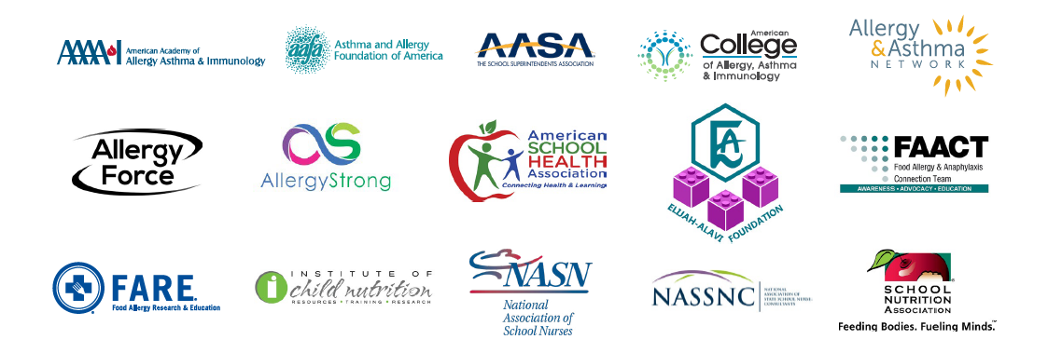
Approach/ Work Plan
  Who endorsed the FAMS Recommendations?
Notes:
Once the Advisory Council of experts drafted the Expert Recommendations (after months of meetings, and dialogue), the draft FAMS Expert Recommendations document was circulated among a select group of organizations that are leaders in Allergy and/or school health.
The organizations represented here have all fully endorsed the 2024 FAMS Expert Recommendations.

Slide 6
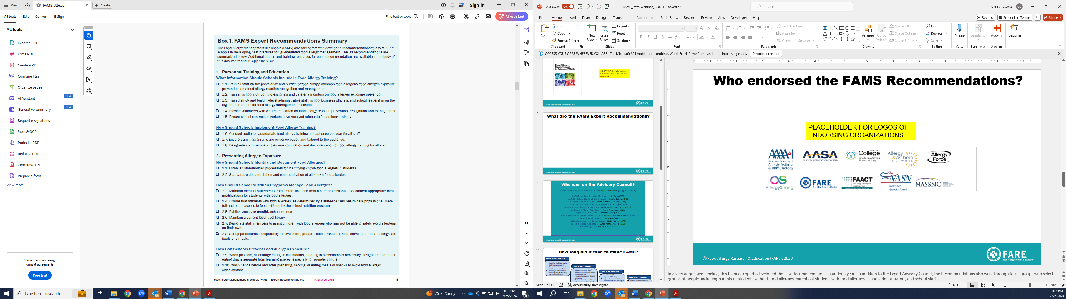
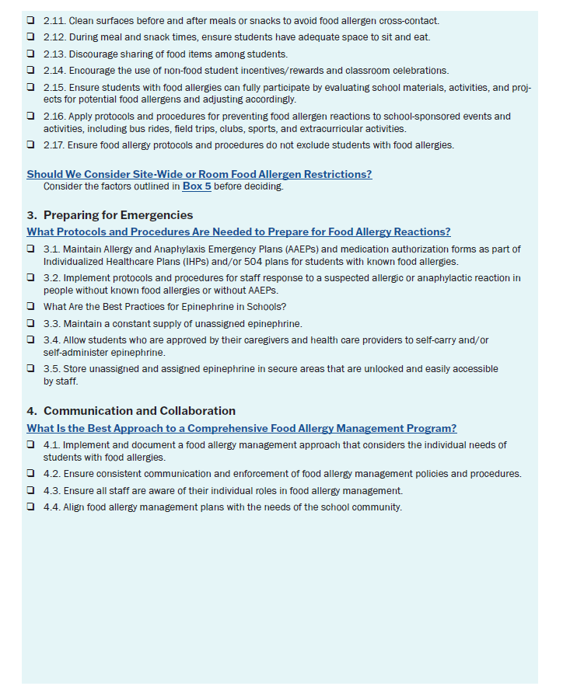
  What are the FAMS Expert Recommendations?
Notes:
This summary shows the 34 Recommendations from the Expert Advisory Council. This is a summary found on pages 8 and 9 of the FAMS Expert Recommendations document.
Let’s look at each of the 4 categories individually.

Slide 7

Deliverables
  What are the 4 Sections of the FAMS Expert Recommendations?
  Personnel Training and Education
  Preventing Allergen Exposure
  Preparing for Emergencies
  Communication and Collaboration
Notes:
Here are the four sections of the FAMS Expert Recommendations document.
(CLICK TO BUILD EACH AND READ ALOUD)
Let’s take a look at Section 1.

Slide 8
  Section 1: Personnel Training and Education
Notes:
The first section of the FAMS Expert Recommendations document focuses on personnel training and education.
You can see specific questions that schools may ask themselves, and the Recommendations for how a school or school system can effectively address that question.
(CLICK TO ANIMATE) – For example, What Information Should Schools Include in Food Allergy Training?
Reference some resources that can be used for training including Keeping Students Safe and Included and Food Allergy Safe Schools: The Basics (1-pager) that can be helpful with volunteers.

Slide 9
  Section 1: Personnel Training and Education
Notes:
Then you can see each of the 5 Recommendations under the question.
(CLICK TO ANIMATE) – For example, 1.1 is the Recommendation that states ‘Train all staff on the prevalence and burden of food allergy, common food allergens, food allergen exposure prevention, and food allergy reaction recognition and management.
You can then turn to the relevant page showing a detailed breakdown of what this recommendation includes.

Slide 10
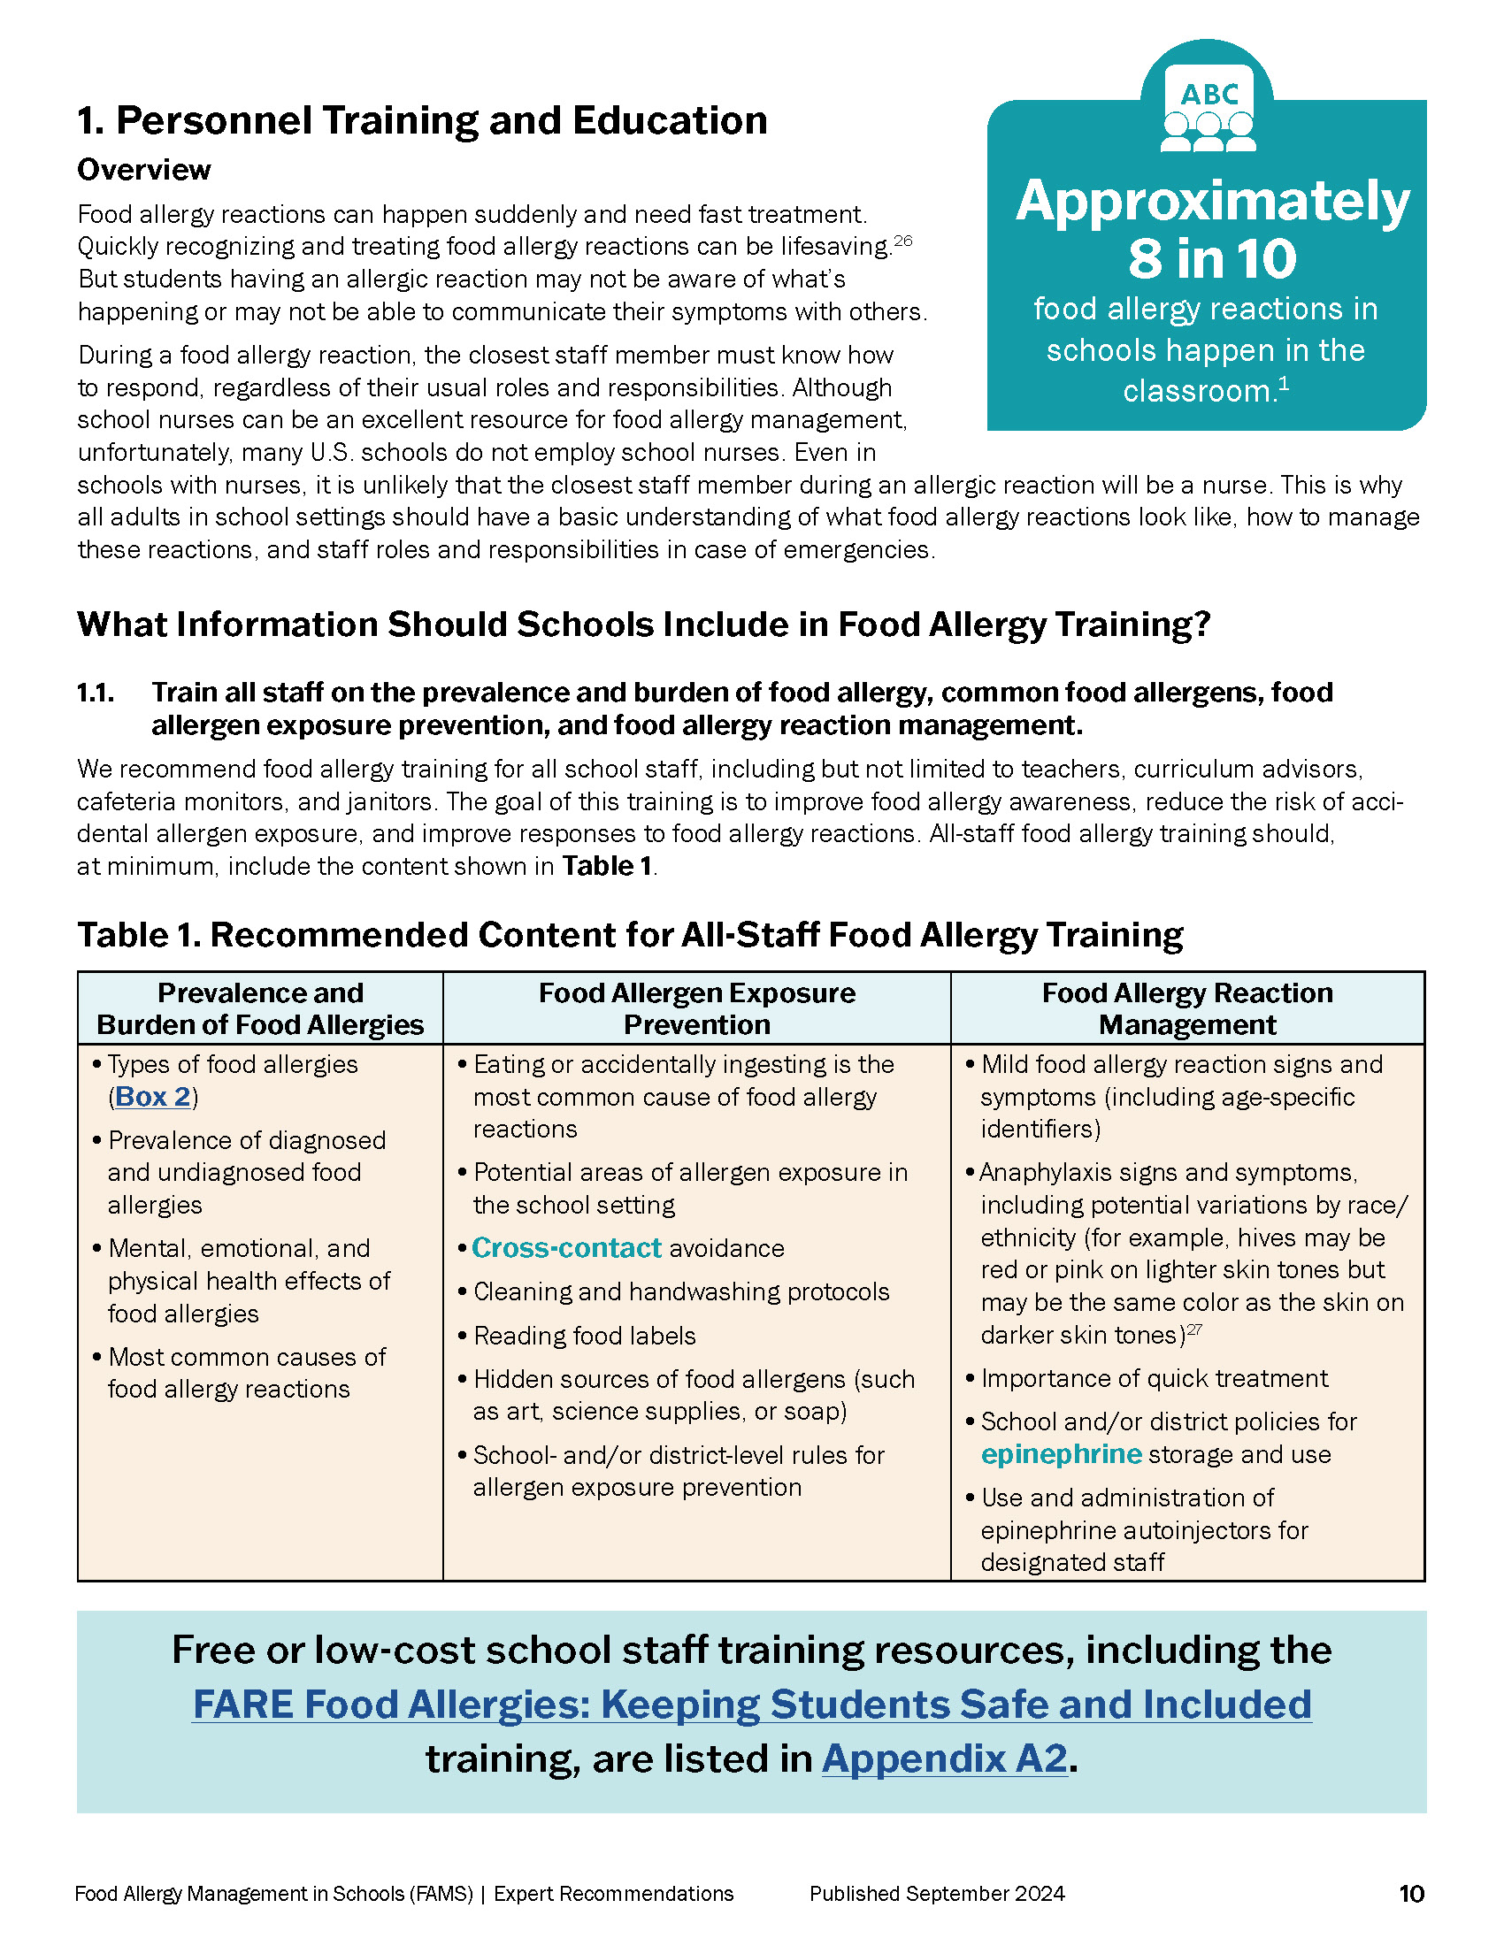
  Section 1: Personnel Training and Education
  Recommendation 1.1
Each section has an overview
Each Recommendation # corresponds with the summary
Each Recommendation has considerable detail and references
Glossary terms are called out in teal font
Active links to available resources are included
Notes:
Each section is built in a similar manner.
(Click to build each text box)

Slide 11
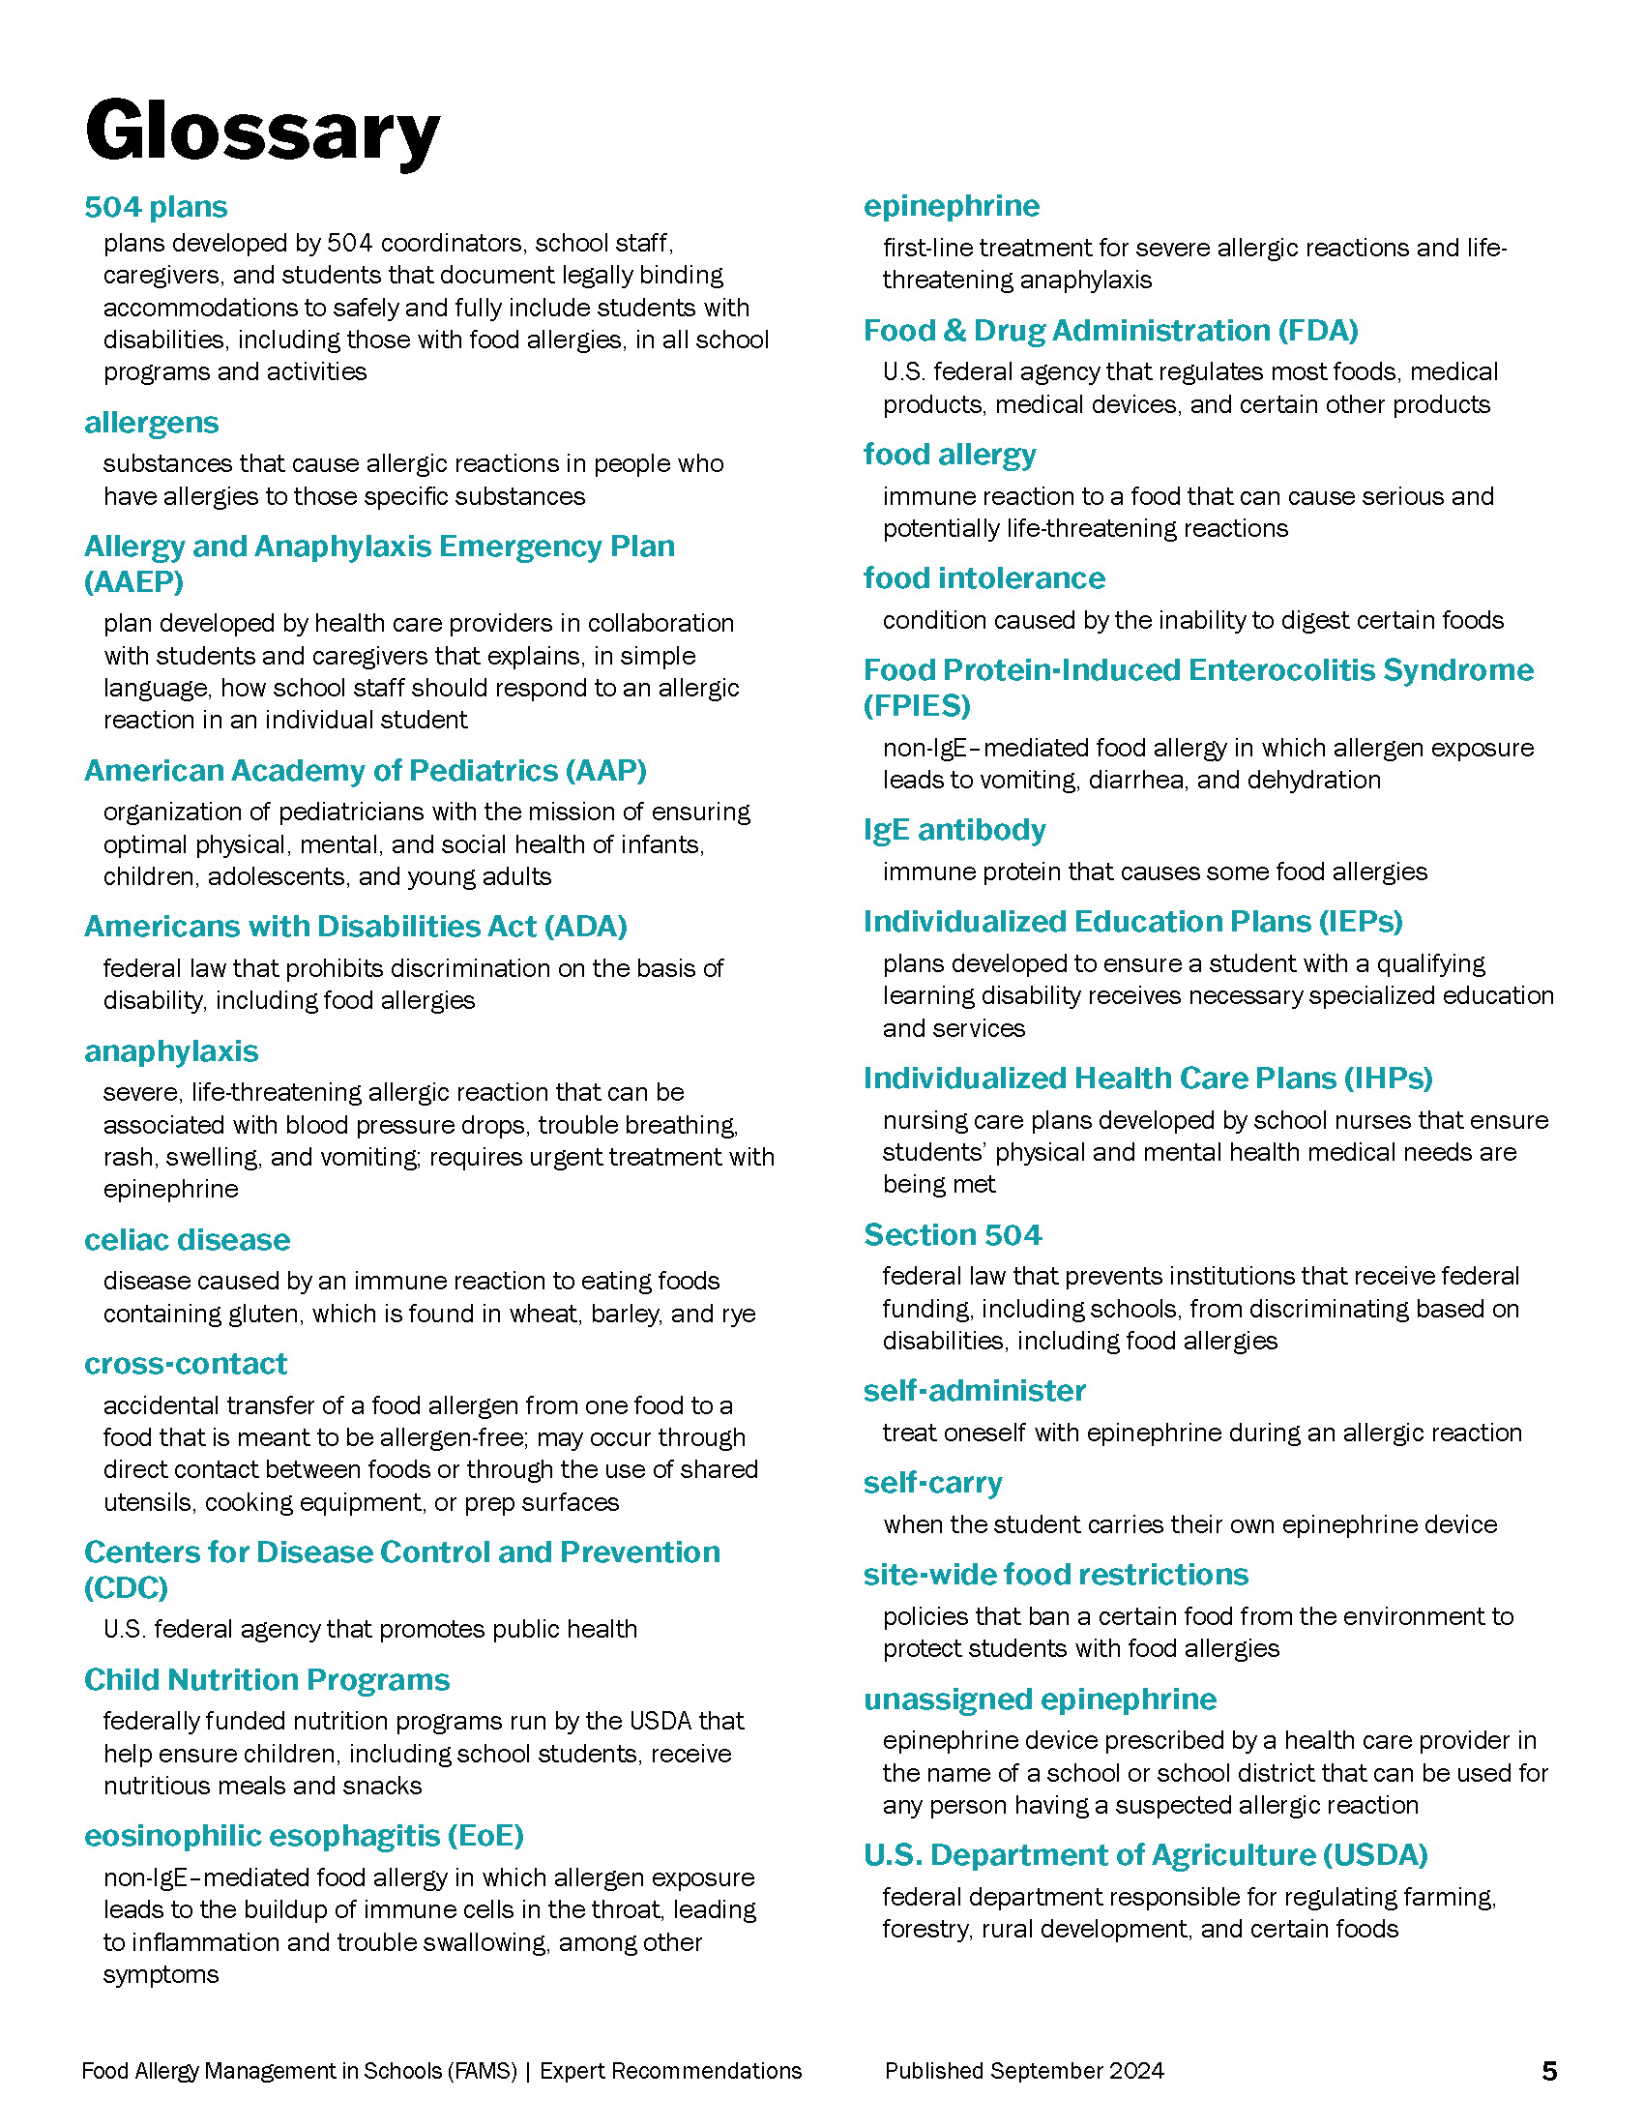
  Glossary – Page 5
FPO
Notes:
The glossary can be found on page 5.

Slide 12
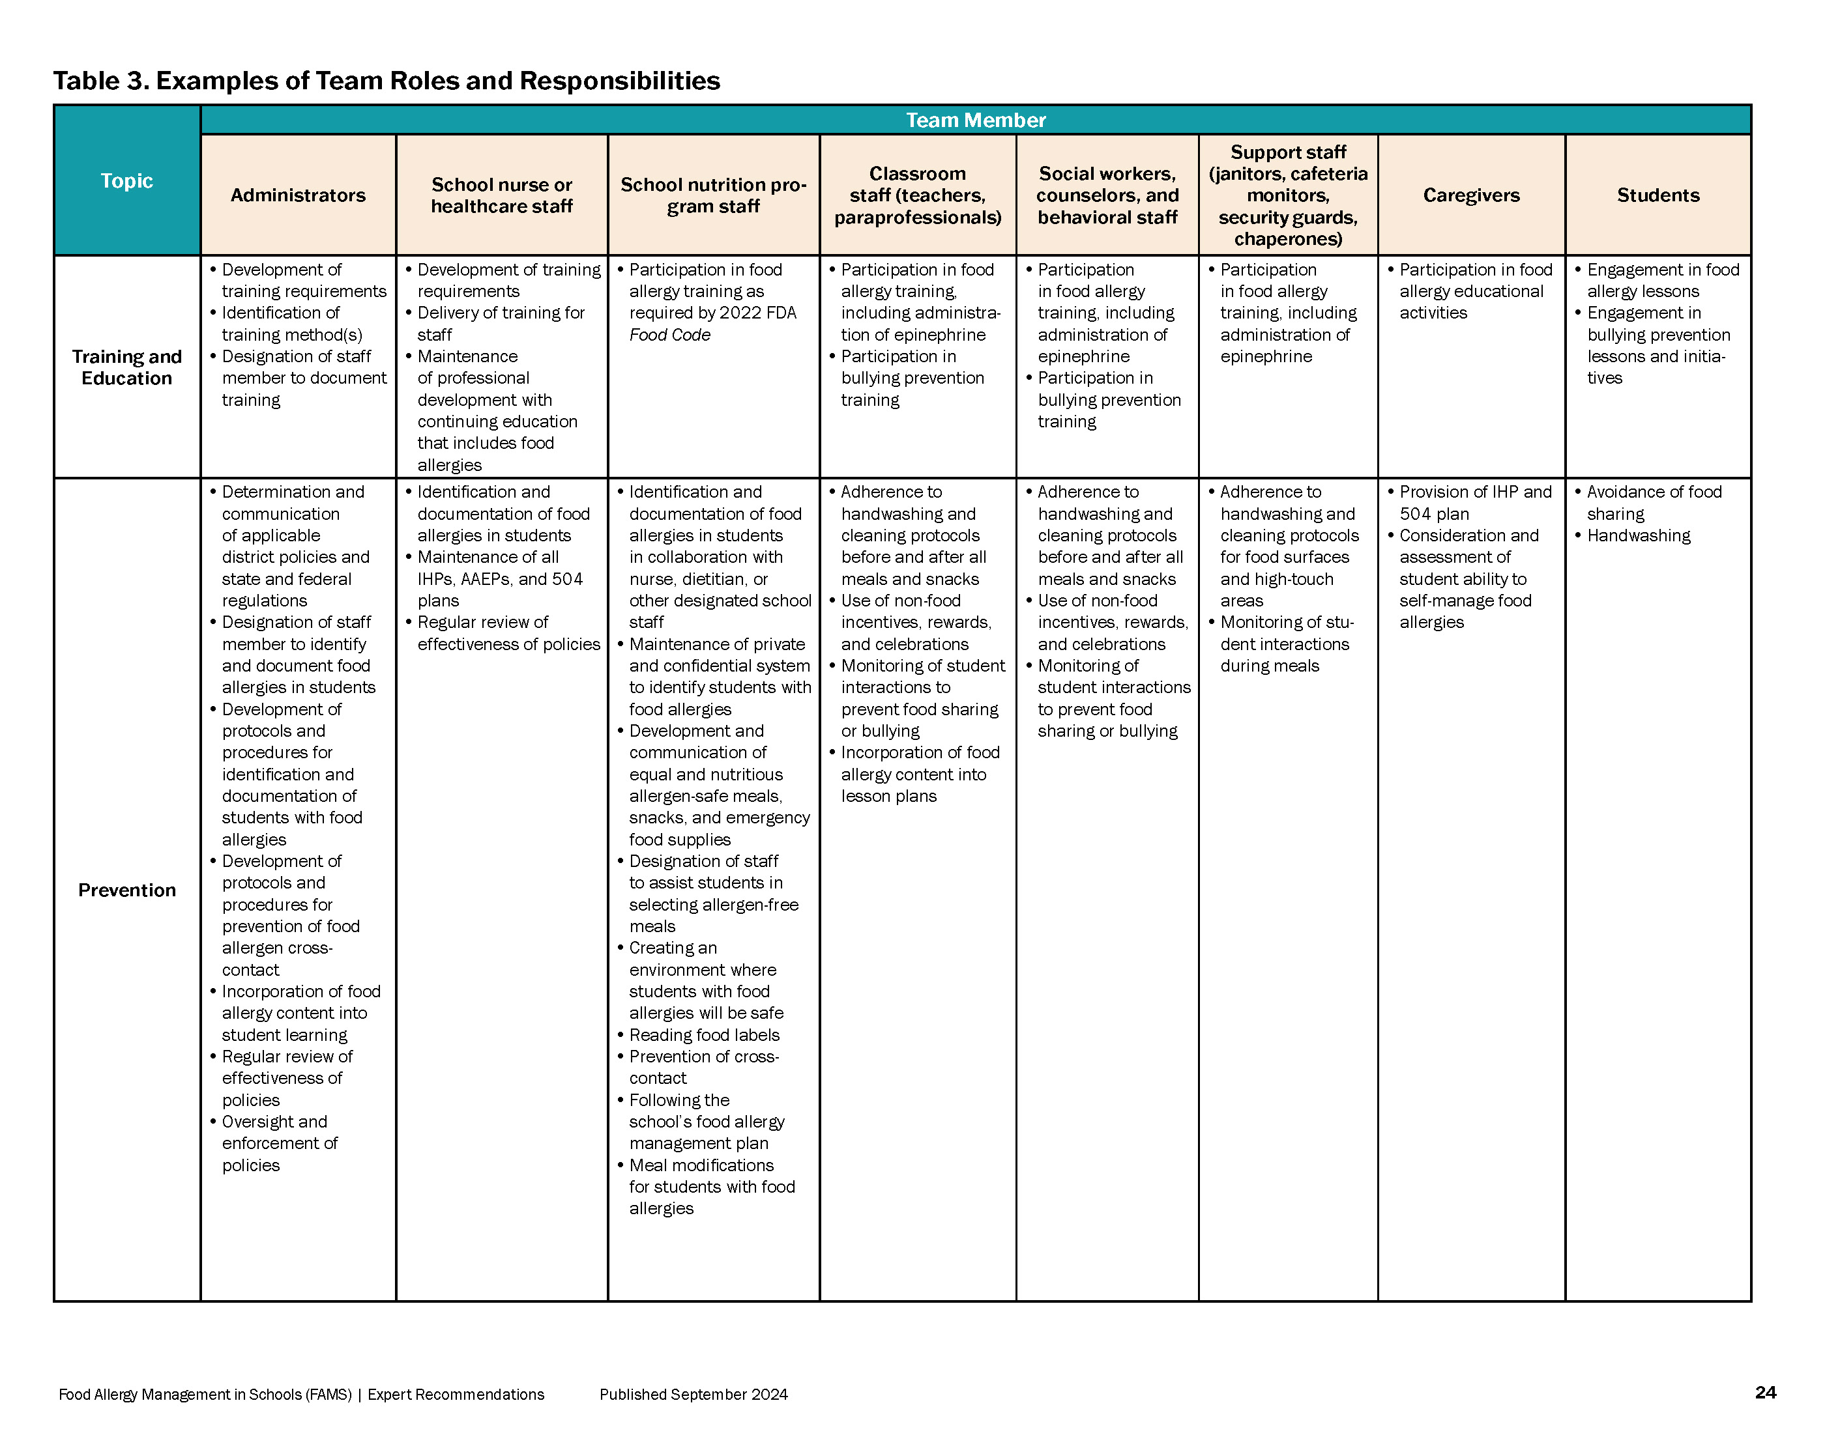
  Tables and Resources
There are useful Tables throughout to break down information
FPO
Notes:
There are useful tables throughout to help break down information. For example, this is Table 3 in Section 3 that helps outline the roles and responsibilities for different team members when it comes to food allergy management in schools.

Slide 13
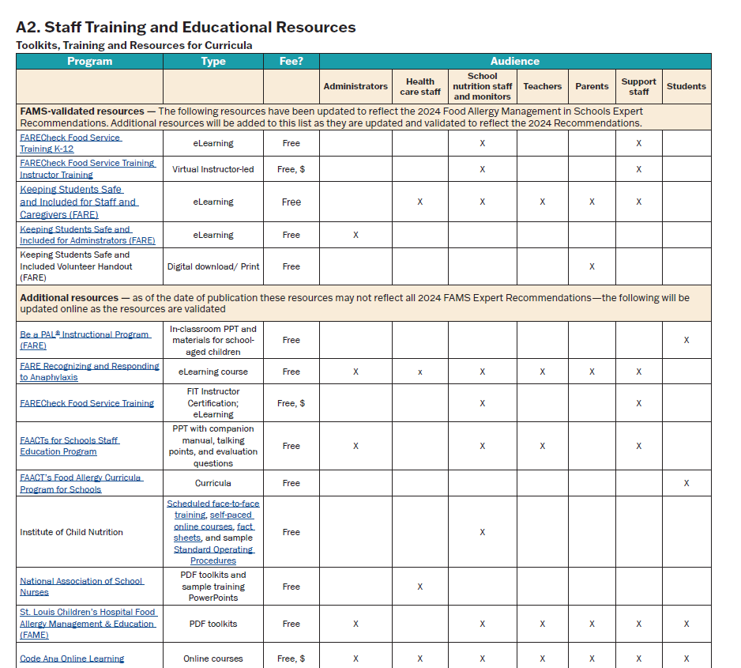
  Tables and Resources
The Appendix has a list of:
Valuable training resources
Links to access them
Who the training is appropriate for
The modality of the training
Free or if there is a fee to access the training
Notes:
The Appendix also has a list of valuable training resources with live links to access them, the modality of the training, if there is a fee, and who the training is best suited for.
Please note that because the FAMS Expert Recommendations are newly published, we can only validate the resources at the top of the list at this time. Please check back online for updated publications as other training resources are validated to be in alignment with the 2024 FAMS Expert Recommendations.

Slide 14
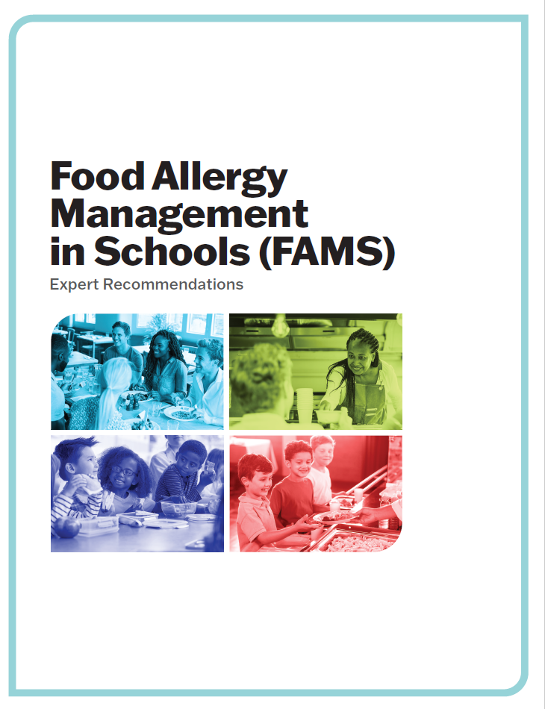
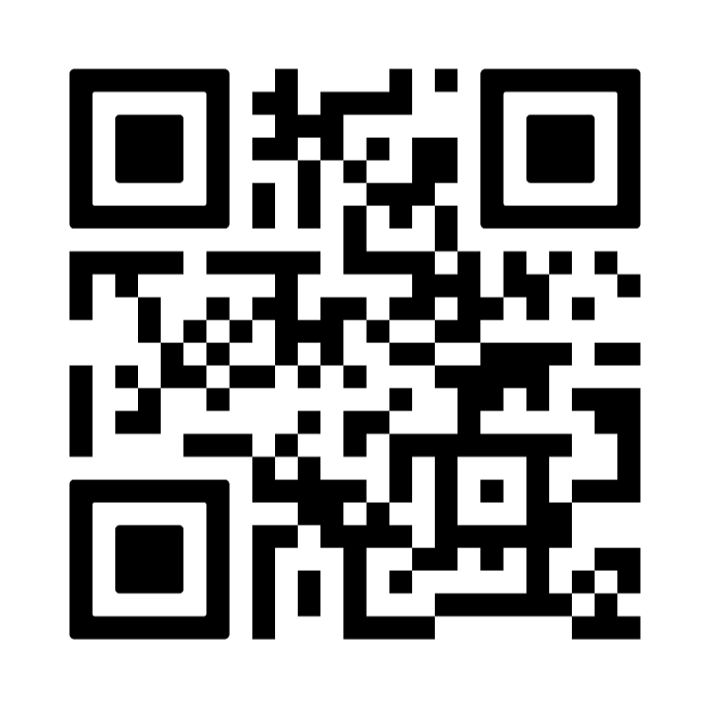
  How can I access the FAMS document?
www.FoodAllergy.org/FAMSExpertRecommendations
Notes:
Use the QR code or type the link into your browser to access a downloadable version of the FAMS Expert Recommendations.

Slide 15

What can you do with the
Food Allergy Management in Schools:
Expert Recommendations?

Slide 16
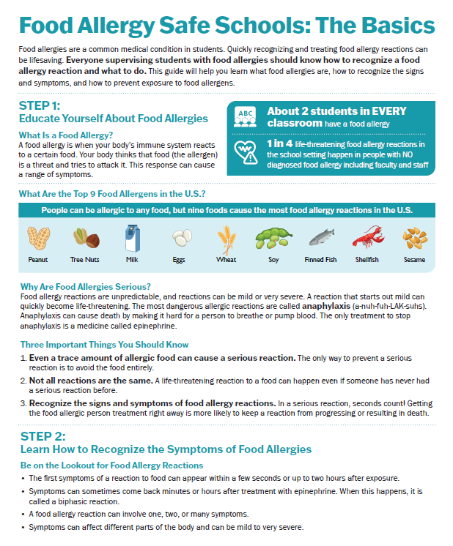
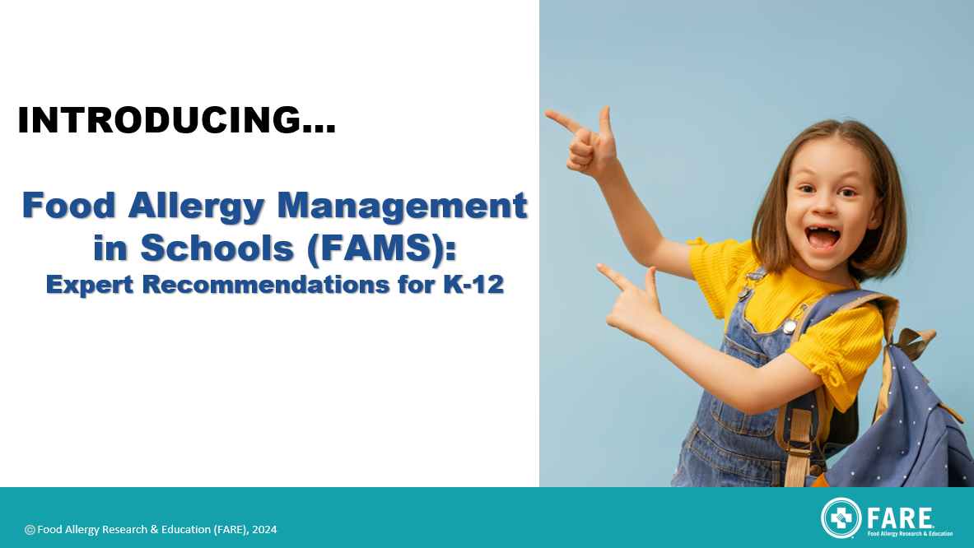


  FARE FAMS Resources Overview
Food Allergy Management in Schools (FAMS): Expert Recommendations document
Handout to help volunteers, temporary staff, or contractors understand food allergy safety basics.
Slide deck FAMS overview to be used in training staff about FAMS: Expert Recommendations and resources to support integration of recommendations into schools.
FREE Training on the FARE at FoodAllergyAcademy.org - Admin. & School Staff/Parent versions available.
Simple education curriculum that helps children and teens learn how to Protect A Life by being a good friend to kids with food allergies.
www.FoodAllergyAcademy.org
Notes:
Use the QR code or type the link into your browser to access a downloadable version of the FAMS Expert Recommendations.

Slide 17
FAMS
in
Action
Audience | Action Recommendations
Administrators | Review the "FAMS: Expert Recommendations" & share with staff along with PTO and PTA associations Complete "Keeping Students Safe & Included (KSSI)" admin. version Work to update district and/or school policies and procedures to reflect the recommendations
School Staff and Caregivers | Review the FAMS Document Complete "Keeping Students Safe & Included (KSSI)" school staff and caregiver version Train students using FARE’s “Be a PAL (Protect A Life)" classroom curriculum
Everyone | Provide the "Food Allergy Safe Schools: The Basics" handout to volunteers, contractors, & short-term staff
ALL RESOURCES AVAILABLE AT:
www.FoodAllergy.org/FAMSExpertRecommendations

Slide 18
Contact FARE
if you have any questions!
For questions or more information please email:
Education@foodallergy.org

