Slide 1
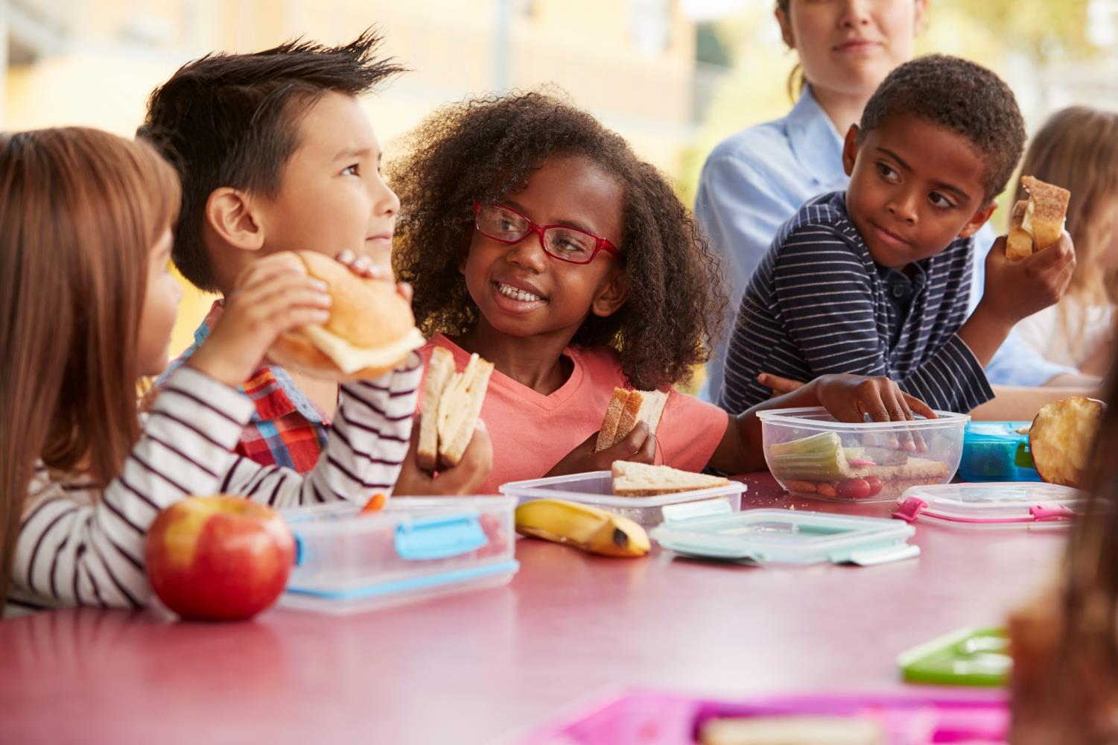


Be a PAL (Protect A Life)
Food Allergy Awareness
What are food allergies?
Who has food allergies?
How can you help people with food allergies?
© Food Allergy Research & Education (FARE), 2023, www.FoodAllergy.org
© Food Allergy Research & Education (FARE), July 2023
Food Allergy Research & Education (FARE), 2023
7
9

Slide 2

Food allergies are serious, and they affect kids just like you.
1 in 13 kids has a
food allergy.
That’s two kids in every classroom in the United States!
© Food Allergy Research & Education (FARE), 2023
© Food Allergy Research & Education (FARE), July 2023
2
7
9

Slide 3
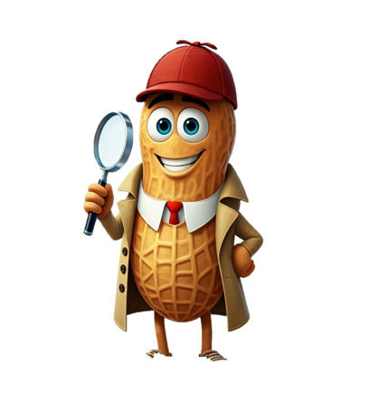
What is a food allergy?
What is a food allergy?
Some people’s bodies think that certain foods are harmful, even if other people can eat them every day.
If a person eats a food they’re allergic to, they can get very sick. This is called an “allergic reaction.”
There is medicine that can stop the allergic reaction and make them feel better.
© Food Allergy Research & Education (FARE), 2023
3

Slide 4
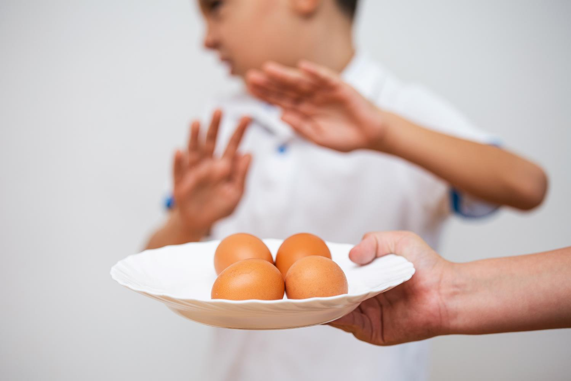
Can doctors cure food allergies?
There is no cure for food allergies.
The only way to keep from having an allergic reaction is to stay away from the food you are allergic to.

Slide 5
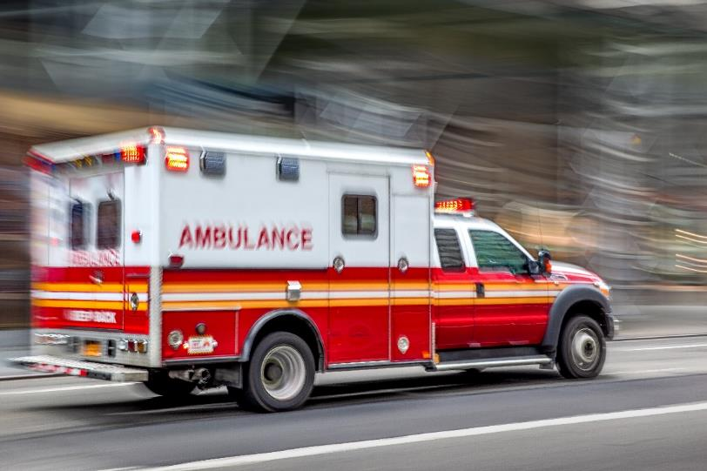
What would happen if my friend eats a food they are allergic to?
Some reactions can be more serious than others. Your friend could get very sick right away, even from just a tiny bit of a food they are allergic to.
They would need their medicine very quickly and may need to go to the hospital.

Slide 6
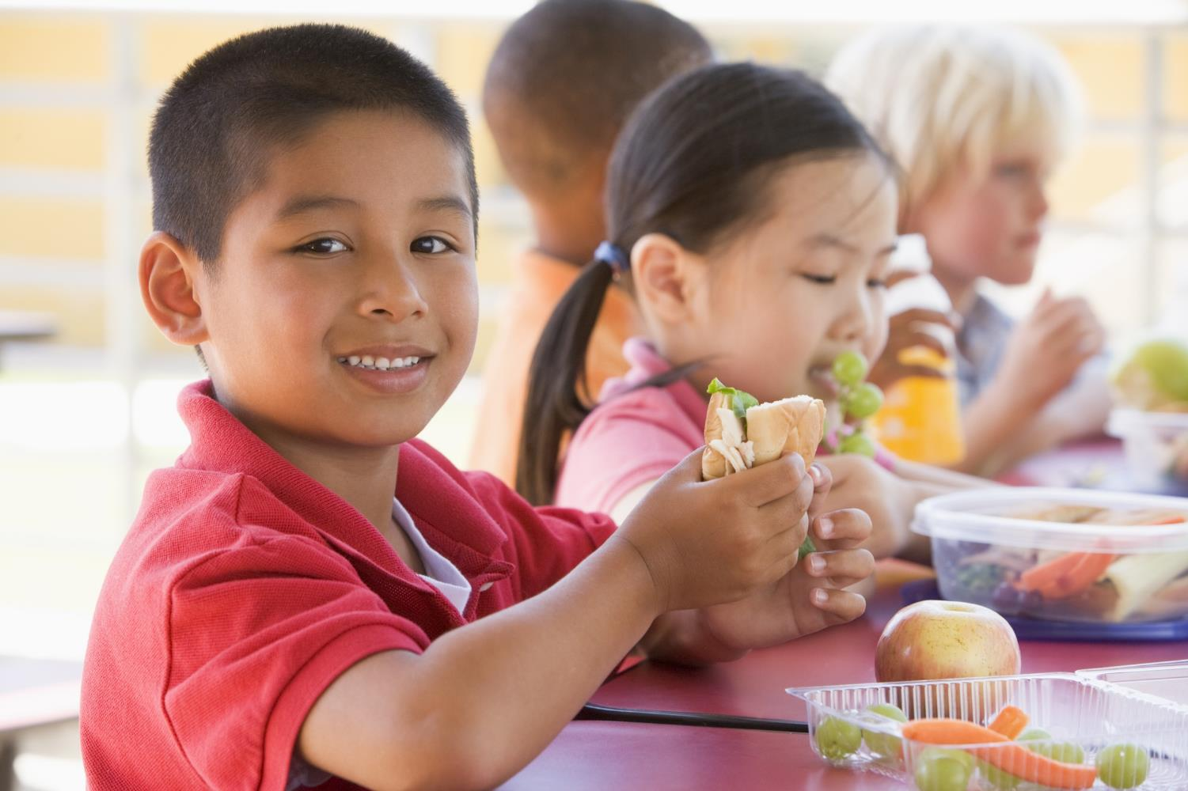
Learn how
to
Be a PAL
(Protect A Life)
to Friends with Food Allergies
© Food Allergy Research & Education (FARE), 2023
Food Allergy Research & Education (FARE), 2023
7
9

Slide 7

What can you do to Be a PAL?
Know that food allergies are very serious and can cause death.
Don’t share food with friends who have food allergies.
Wash hands after eating.
If a friend with food allergies feels or looks sick, get help right away!

Slide 8
What Would You Do?
Your friend, Stephen, has a food allergy.
As you and Stephen walk out of the cafeteria, he says his stomach hurts.
You ask him to play with you at recess, but he says he wants to lie down.
He says it feels like there is something stuck in his throat.
© Food Allergy Research & Education (FARE), 2023

Slide 9

A PAL would…
  Get an adult right away or dial 911!

Slide 10
What Would You Do?
You and Stephen are playing with another friend, Max.
Max offers Stephen a cookie from his backpack.
Stephen says, “No thank you, I have a food allergy.”
Max says, "Come and have some, it’s probably OK.”
©Food Allergy Research & Education (FARE), 2023

Slide 11
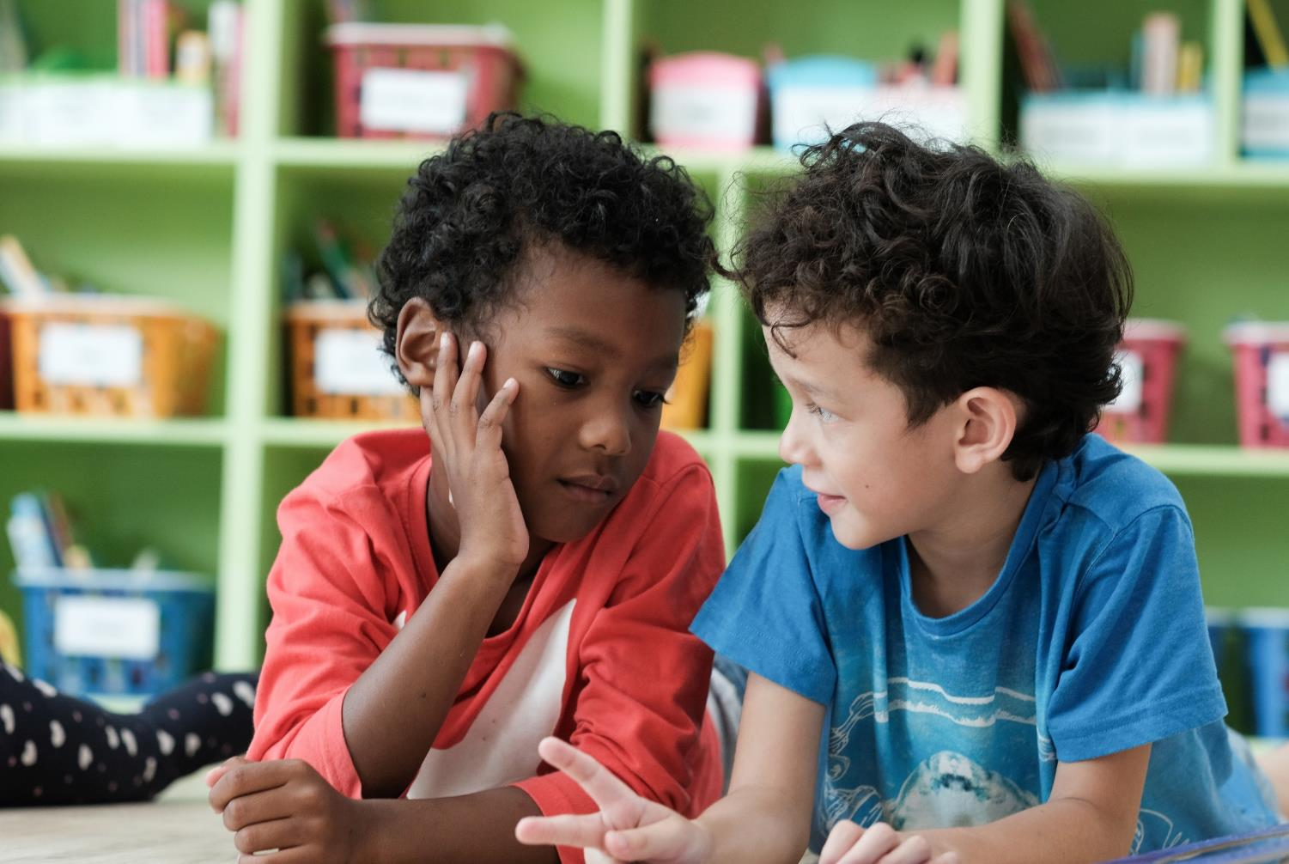
A PAL would…
Tell Max that even one bite of the wrong food could make Stephen sick.
Wait to have snacks until later or ask an adult to help find a snack that is safe for him.

Slide 12
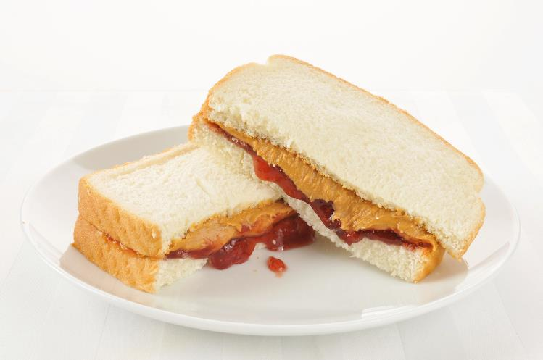
What would you do?
Two kids in your class are allergic to milk and peanuts.
Before school, you ate peanut butter toast and drank a glass of milk.

Slide 13
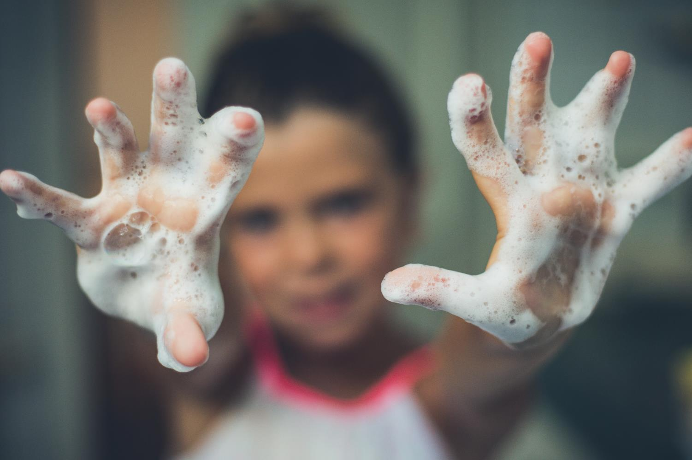
  A PAL would…
  Wash your hands and face with soap and
  water before leaving for school.

