Slide 1
Food Allergy 101: A Crash Course for the Newly Diagnosed
Presented by: Dr. Kristin Sokol
May 2020
Notes:
Hello everyone, and welcome to today’s presentation. My name Karie Mulkowsky, National Programs Sr. Manager at FARE, and your moderator for this discussion.
A little bit of housekeeping before we get started: This presentation will be recorded and posted on the FARE website in about 7-10 days. Please note that for maintaining a quality recording, all attendees will be muted throughout the webinar. However, if you are having any technical difficulties you can use zoom’s “chat” feature to submit questions. If time permits, we will respond to some moderated questions for our presenter at the end of the webinar.
Lastly, for those of you on Twitter, we encourage you to join us in conversation there during the broadcast. You can follow along with us at our handle @FoodAllergy and the hashtag FAREwebinar.

Slide 2
Today’s Presenter
Kristin Sokol, M.D., MS, MPH, FAAAAI
Notes:
Now without further ado, I’m delighted to introduce today’s presenter: Dr. Kristin Sokol.
Dr. Sokol is a board-certified allergist/immunologist and board- certified pediatrician specializing in the care of both adult and pediatric patients with a variety of allergic and immunologic disorders. She was thrilled to join the practice of Schreiber Allergy in the summer of 2019. Prior to this, she was an assistant professor at the University of Texas Medical Branch in Galveston, TX and at Beth Israel Medical Center in Boston, MA. She then joined the NIH in Bethesda, MD, where she treated patients and performed research in the field of food allergy and the genetics of allergic disease.
Dr. Sokol serves as Secretary of the American Academy of Allergy, Asthma, and Immunology (AAAAI) Health Outcomes, Education, Delivery and Quality Interest Section. She was named an AAAAI Choosing Wisely Champion in 2016 for her work with the Choosing Wisely campaign, bringing awareness to the need for reducing overuse in healthcare. She believes in delivering the highest quality of care while at the same time helping patients choose tests and procedures that are truly necessary.
She has published numerous articles in peer-reviewed journals, has co-authored several book chapters, and has been invited to give talks regarding the diagnosis and management of various allergic and immunologic conditions, including food allergy, allergic rhinitis, asthma, urticaria, mast cell disorders, and primary immunodeficiency. Dr. Sokol lives in Chevy Chase, MD with her husband, 3 children and their dog. She enjoys spending time with her family, exploring the DC area, and practicing yoga.
At this time, I am delighted to turn the presentation over to Dr. Vickery

Slide 3
My Child Has A Food Allergy – Now What?
It’s not your fault
It’s not your fault
It’s not your fault
And… You are not alone!!

Slide 4
My Child Has a Food Allergy…Now What?
Communication with physician
Shared decision making
Coming up with a plan
Know your online and offline resources
Managing fear and anxiety…especially during time of COVID

Slide 5
You Are Not Alone!
70% report significant effect on social events
60% report significant effect on meal prep
40% report significant ↑ in stress
34% report ↓ school attendance/performance
10% parents choose to home school

Slide 6
Back to Basics – What is a Food Allergy?
An overreaction by the immune system to a food protein
The role of the immune system is to protect the body from germs and disease
When a food protein (that the immune system has mistaken as a threat) is ingested, the immune system thinks the food is harmful and releases histamine and other chemicals to “attack” the enemy
Food allergy reactions occur every time that food is ingested, are reproducible over time, and happen quickly

Slide 7
Back to Basics – What is a Food Allergy?
Food Allergy Food Intolerance
Food intolerance - Does NOT involve the immune system, NOT life-threatening
Takes place in the digestive system (GI tract)
Inability to properly breakdown that food → bloating, stomach cramping, gas, diarrhea
Food allergy involves the immune system - can cause a serious or life-threatening reaction
Notes:
Food intolerance - Could be due to enzyme deficiencies, sensitivity to food additives or reactions to naturally occurring chemicals in foods. Often, people can eat small amounts of the food without causing problems
Another concern – Food Allergy often misdiagnosed: -Correlation mistaken for causation -Symptoms mislabeled as ‘allergy’ Common concerns but unlikely causes of true allergy: -Strawberries -Artificial coloring -Chocolate

Slide 8
Back to Basics
People can be allergic to any food, but 8 foods cause most food allergic reactions in the US:
Milk
Egg
Peanuts
Tree nuts
Wheat
Soy
Fish
Shellfish
(Sesame = #9)

Slide 9
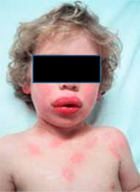
Back to Basics
A range from mild to severe manifestations of allergic reaction:
Oral cavity: mouth/tongue/throat itching or swelling
Skin: flushing, itching, rash, hives aka welts
Respiratory system: wheezing, shortness of breath, cough
GI tract: nausea, abdominal cramps, vomiting, diarrhea
Cardiovascular system: ↑ heart rate, ↓ blood pressure, fainting
Anaphylaxis = a severe allergic reaction, can happen quickly, may cause death, more than 1 organ system involved
Not all reactions are the same
Notes:
You can still have a life-threatening reaction to your problem food, even if you have never had a serious reaction before. Past reactions do not predict future reactions!
Death from Anaphylaxis: Frequency: Only 164 cases in 10 years – this is a rare occurrence
Risks include Underlying asthma, Delayed epinephrine, Symptom denial, Previous severe reaction
History: known allergic food
Biphasic reaction (= recurrence of symptoms within 72 hours of symptoms without another exposure to food)
Lack of skin symptoms

Slide 10
Back to Basics – Young Kids
This food is too spicy
My tongue is hot
It feels like something’s poking my tongue
My mouth is tingling
My tongue itches
My tongue feels like there is hair on it
My mouth feels funny
There’s something stuck in my throat
My tongue feels full/heavy
My lips feel tight
It feels like there are bugs in my ears
My throat feels thick
It feels like a bump is on the back of my tongue/throat
There’s a frog in my throat
My belly hurts
Notes:
Some examples of how a young child might describe a reaction

Slide 11
**Managing Food Allergies in time of COVID
Contact Allergist – for new suspected allergy or follow-up of known allergy
TeleHealth/TeleMedicine - widespread use now!
Can manage a lot via a live visit over the internet – might not require urgent in-office testing
Review Food Allergy Action Plan!
Notes:
Self diagnosis often equals misdiagnosis. Food allergy should never be diagnosed with any form of 'at home' testing. Majority of these are IgG tests, which are not validated or useful to diagnose any condition, including food 'sensitivity'.

Slide 12
Managing Food Allergies – Avoiding Foods
Read every label, every time
Be aware of cross-contact
Direct vs. Indirect
Notes:
Cross-contact happens when one food comes into contact with another food and their proteins mix. As a result, each food then contains small amounts of the other food. These amounts are so small that they usually can’t be seen.
Even this tiny amount of food protein has caused reactions in people with food allergies!
The term “cross-contact” is fairly new. Some people may call this “cross-contamination.”
Direct Cross-contact – when an allergen came into direct contact with food (peeling cheese of of a cheeseburger, picking shrimp out of a salad)
Indirect Cross-contact – Allergen was not directly applied (using a spatula that flipped a cheeseburger, not properly cleaning a knife used for a PB sandwich)
Use utensils, cutting boards and pans that have been thoroughly washed with soap and water. Consider using separate utensils and dishes for making and serving safe foods. Some families choose a different color to identify the safe kitchen tools.
If you are making several foods, cook the allergy-safe foods first.
Keep the safe foods covered and away from other foods that may splatter.
If you make a mistake, you can’t just remove an allergen from a meal. Even a small amount of cross-contact makes a
food unsafe.
Wash your hands with soap and water before touching anything else if you have handled a food allergen. Soap and
water or commercial wipes will remove a food allergen. Sanitizing gels or water alone will not remove an allergen.
Scrub down counters and tables with soap and water after making meals.
Do not share food, drinks or utensils. Teach children not to share these when they are at school or with friends.

Slide 13
Managing Food Allergies – Avoiding Foods
What is FALCPA?
A law requiring that food labels show in plain English when a “major food allergen” or any ingredient that contains protein from a major food allergen is added as an ingredient in any pre-packaged food
Imported - sold in US
Domestic - made in US
Notes:
Food Allergy Labeling and Consumer Protection Act

Slide 14
Managing Food Allergies – Avoiding Foods
These foods make the FALCPA list: milk, wheat, egg, peanuts, tree nuts, fish, crustacean shellfish, and soy
Example 1: Ingredients: Whey protein (milk), lecithin (soy), cherry, sugar, natural flavors (almond), salt.
Example 2: Ingredients: Whey protein, lecithin, cherry, sugar, natural flavors, salt. Contains: Milk, soy, and almond.
Notes:
Manufacturers have two options to indicate a major food allergen on product labels. The first option is to list the allergen in parentheses after the ingredient. The second option is to list the allergen at the end of the ingredient list. Often this “Contains” statement is bolded. See the box below for examples of these two options.
The “Contains” statement is one of two options that food manufacturers have for listing the presence of major food allergens and IS NOT REQUIRED!!

Slide 15
Managing Food Allergies – Avoiding Foods
Precautionary warnings or advisory statements like “May contain...” or “Processed in a facility with...” are voluntary
FALCPA does not apply to:
fresh meats
fresh fruits and vegetables
restaurant foods placed in a wrapper or carry out box for an individual customer order
Highly refined oils (even if they are derived from a major allergen, such as peanut or tree nut)
Notes:
1. A manufacturer does not have to warn you that there may be unintentional traces of an allergen due to cross- contact during processing.
2. But Most allergists recommend avoiding these products. Studies have shown that some of the products actually do contain allergens in amounts significant enough to cause an allergic reaction.
FALCPA does not apply to….
Refined peanut oil is generally considered safe for most peanut allergic persons. This is thought to be due to the fact that most, if not all, of the protein is removed during the extraction process. There have been studies into whether reactions occur in peanut-sensitized individuals with exposure to refined peanut oil versus crude peanut oil. Those who participated in one study did not have a reaction to refined peanut oil and 10% had a reaction to crude peanut oil. Other studies are conflicting, showing that a small number of peanut allergic individuals may have a reaction to refined oils. This could be due to cross contact/cross-contamination.

Slide 16
Managing Food Allergies – In the Home
Other siblings – use of color-coding/ labels
Parents
Grandparents/other caretakers
Breast feeding – keep food in mom’s diet (maybe a short trial period of avoidance for eczema)
Notes:
1. Survey done in siblings of those kids with food allergies – revealed that food allergies are a family disease impacting each member of the family in different ways. Siblings were impacted with regards to allergen avoidance, exercising caution around sibling, label checking and helping with Epi, worrying about the sibling, sometimes receiving less attention because of sibling with food allergy, - Tamara Hubbard

Slide 17
Managing Food Allergies – Outside the Home
Empowering your child – identify safe foods/snacks
Dining out
Reading food labels
Schools, daycares, etc.
Emergency identification bracelets

Slide 18
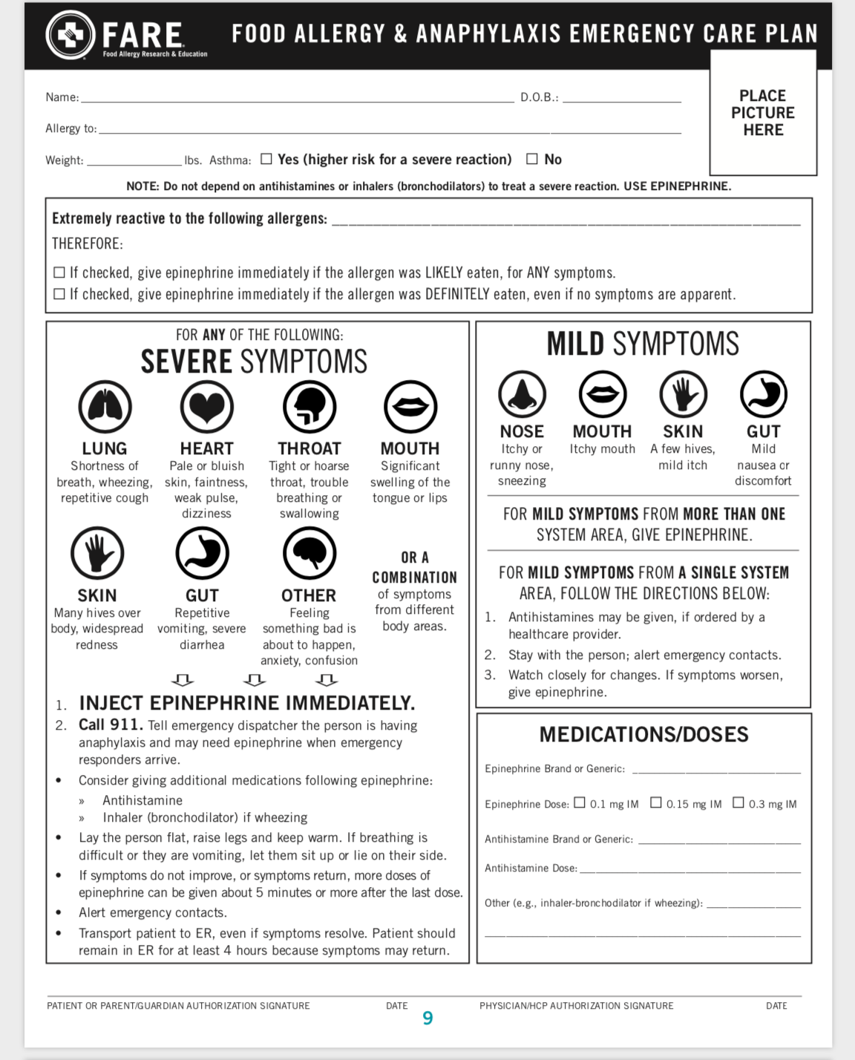
Managing Food Allergies – Plan Ahead
Allergy Action Plan
Make copies
Keep with medication pack
Notes:
Each person with food allergy should review their personal anaphylaxis action plan with their own allergist at least annually. Preparation = confidence

Slide 19
Managing Food Allergies – Treat a Reaction
Antihistamines vs. Epinephrine
Keep 3 labeled medication packs
One for home in easily accessible location
One for “on the go” that can easily switch from bag to bag
One for school/daycare/caretakers home
Notes:
Antihistamines (Benadryl, Zyrtec, Claritin, Allegra) - Secondary therapy, Can be used in mild reactions: hives, rash, itching, swelling

Slide 20
Managing Food Allergies – Treat a Reaction
Epinephrine is the only medication that can reverse the symptoms of anaphylaxis
Generalized hives; difficulty breathing, swallowing, or talking; vomiting; passing out
Antihistamines will NOT help with a severe reaction
For severe reactions, act quickly: Give epinephrine! Call 911!
Second dose of epi may be necessary if symptoms not resolved in 5-10 min.

Slide 21
Managing Food Allergies – After Epi
Call 911 – OR NOT? COVID has affected this
Observation in ED
Let your allergist know about reaction
** Telehealth video visit after reaction**
Manage fears and anxiety
Epi just as effective the next reaction

Slide 22
Why Are Food Allergies Increasing?
Late introduction of certain foods?
Hygiene hypothesis?
Dual allergen exposure hypothesis?
Increased use of antibiotics?
Increased use of antacids?
Increased use of antibacterial soaps/sanitizers?
Birth by cesarean section?
Differences in our microbiomes?
Notes:
The “dual allergen exposure hypothesis” attributed to Gideon Lack was considered by this group to have limited but consistent evidence that an impaired skin barrier plays a role in sensitization as a first step toward food allergy. This theory describes that exposure to food allergens through the skin can lead to allergy, while ingestion of these foods at an early age may actually result in tolerance (or no allergy). Depending on the balance of these exposures, either tolerance or allergy will “win.” Children with eczema, for example, have a disrupted skin barrier that could allow exposure to food proteins in the environment – such as peanut oil in creams or peanut residue on tables. Under the hypothesis, if these children avoid peanuts but are still exposed to them in the environment, they might be more likely to develop peanut allergy.
Antacids – reduce the digestion of allergens?

Slide 23
Treatment Options for Food Allergies
Is there a cure?
OIT experience in our clinic
OIT in research
Desensitization vs. Tolerance
Quality of Life
OIT vs. SLIT vs. EPIT

Slide 24
(Future) Treatment Options for Food Allergy
Clinical trials - potential for entering clinical practice:
Allergen-specific
Extensively heated milk or egg diet
Subcutaneous cross-immunotherapy with pollen
Milk OIT combined with anti-IgE (omalizumab)
Allergen non-specific
Anti-IgE (omalizumab/Xolair)
Probiotics and prebiotics
Anti-IL-5
Chinese herbs
Preclinical studies:
Peptide IT
TLR-9 agonist
Heat-killed E. coli expressing modified Ara H 1,2,3 rectal vaccine

Slide 25
Can my child outgrow their food allergy?
Cow’s milk - 85% outgrow by 8 yrs
Egg - 66% outgrow after 5 yrs
Peanut - 20% may outgrow (8% may recur)
Tree nut and seafood typically persist

Slide 26
Can we prevent food allergy?
Emerging evidence suggests:
Less use of drying soaps/ detergents and more use of nonallergenic moisturizers → optimization of early life skin barrier function
Solid introduction: Infants should be introduced to solids ~ 4-6 months irrespective of family history
Allergenic solids do not need to be avoided by infants when solids are introduced
Allergenic solids do not need to be avoided by mothers when breastfeeding

Slide 27
Can we prevent food allergy?
Human milk should be the first and most important source of nutrition for infants
Human milk influences many physiological systems and promotes normal gut colonization
However, its role in protection against food allergy risk remains unclear
Notes:
Human milk contains a vast array of bioactive factors including hormones, growth factors, neuropeptides, anti-inflammatory, and immunomodulatory agents

Slide 28
Can we prevent food allergy?
Modified/hypoallergenic formula for infants: premature recommendation – not enough data
Probiotics or prebiotics: Insufficient data re: protection against food allergy
Vitamin D as a prevention or treatment for FA: Insufficient evidence
Notes:
with the results of an updated Cochrane review expected to further inform infant feeding guidelines

Slide 29
Diagnosis of Food Allergy in Younger Siblings
To test or not to test?
Beware of false positives
Oral food challenges (OFCs) should be routine if any question
Notes:
Gupta et al⁵⁴ evaluated the risk of food sensitization and allergy for siblings of a proband with food allergy. They evaluated 1120 children with food allergy with at least 1 sibling and found that 66.6% of the siblings were food sensitized but only 13.6% were clinically reactive.

Slide 30
Common questions
Daycare/school – do I need to move my child to a nut-free environment?
Flying with food allergies?
Can my child get a flu shot if he/she is allergic to eggs?
Biphasic reactions / Do I really have to go the hospital if I use my Epi?
Cross-reactivity of allergens? Tree nuts, PN/TN, PN/Legumes, milk/soy, milk/beef, cashew/mango, fish

Slide 31
Cross-reactivity

Slide 32
Online resources
FARE website
Kids with Food Allergies
American Academy of Allergy, Asthma and Immunology (AAAAI)
American College of Allergy, Asthma, and Immunology (ACAAI)
Allermates – Food allergy bracelets, medicine cases, activity books, etc.
Living Confidently with Food Allergy
Nationwide Children’s Hospital Allergy and Asthma blog

Slide 33
Offline resources
Your physician
Your (educated) support system
FARE Live Events
Walks
Conferences
Summits

Slide 34
Question & Answer

Slide 35
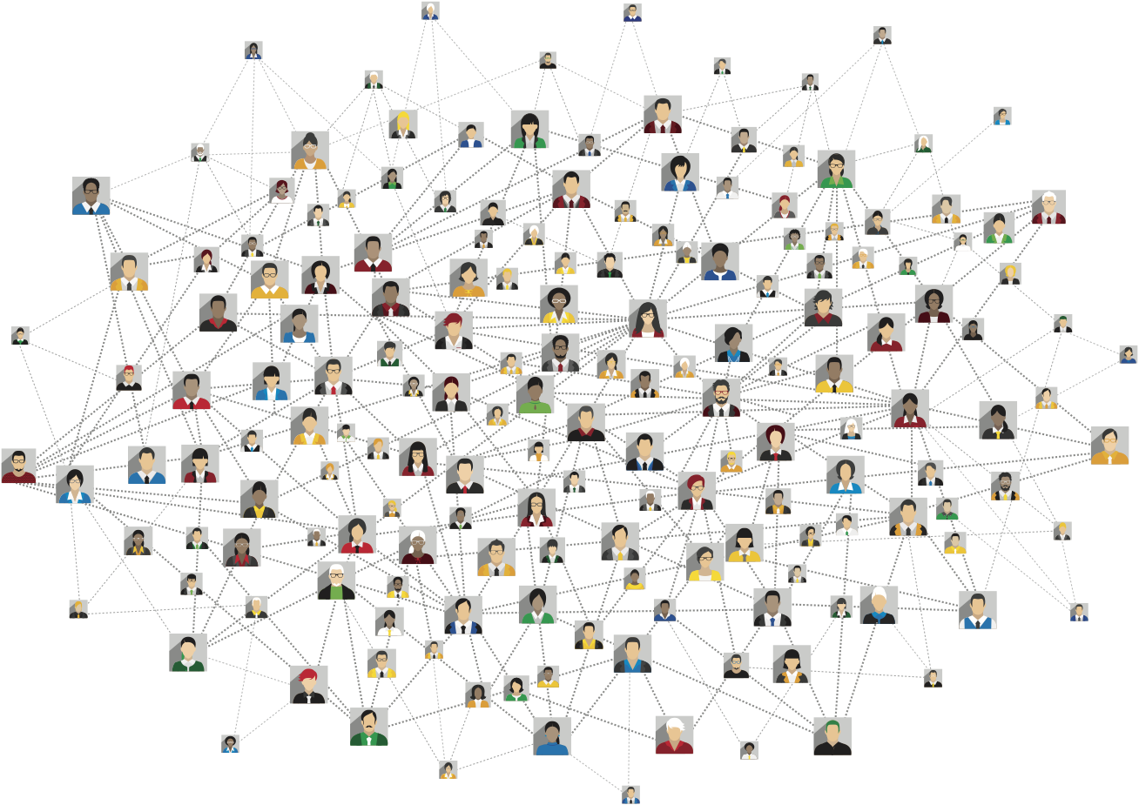
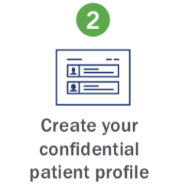
YOUR Food Allergy Story Drives Research Forward
The FARE Patient Registry connects people living with food allergies to researchers seeking answers.
Join in 3 easy steps:
JOIN TODAY at FAREregistry.org
Notes:
Even in these extraordinary times of social distancing and canceled events, we can each still actively support food allergy research through the FARE Patient Registry®. It’s all online and joining and completing surveys based on your/your child’s food allergy experience is easy, quick and secure. Sharing your food allergy story with researchers will make a difference. Thank you! Please join today at FAREregistry.org

Slide 36
Thank you!
Notes:
This will conclude today’s webinar.
I’d like to once again thank Dr. Sokol for joining us today.

